Slide 1
Welcome!
Public & stakeholder engagement
for engineering & construction projects in alaska
2021 Moolin Project Management Seminar

Slide 2
Remarks outline
Seminar history
Agenda review
Supporter acknowledgements
Zoom platform protocol
Seminar evaluation
PDH certificate
Remember ALL stakeholders

Slide 3
Seminar history, briefly
Frank Moolin and the Moolin Endowment
2013 – Mega Projects
2015 – Alternative Project Delivery Systems for Governments in Alaska
2016 – Environmentally Sustainable Construction Practices in Cold Regions
2018 – Cold Regions & Remote Construction Projects
2021 – Public & Stakeholder Engagement for Engineering & Construction Projects in Alaska

Slide 4
Agenda review
(handout)
..\Handout\Agenda Final Version -- Moolin 2021.docx

Slide 5
acknowldgements
(handout)
..\Handout\Acknowledgements -- Moolin 2021.docx

Slide 6
No materials? Contact ….
benco@alaska.net
907-347-5384

Slide 7
zooming
Turn off your camera & microphone
Use chat box for questions and comments
We’ll have breakout groups for one session this morning.

Slide 8
Seminar evaluation
Survey Monkey after seminar close

Slide 9
For those who attend full 8 hours …

Slide 10
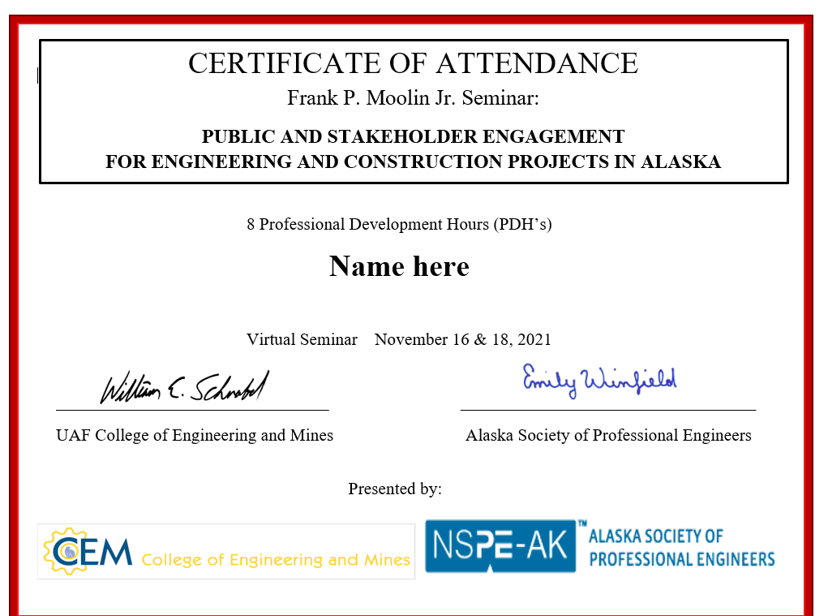

Slide 11
Remember all stakeholders
Not just “the public”
The bridge is open!

Slide 12
COFFEE BREAK
Seminar resumes at 10:15 am

